Slide 1
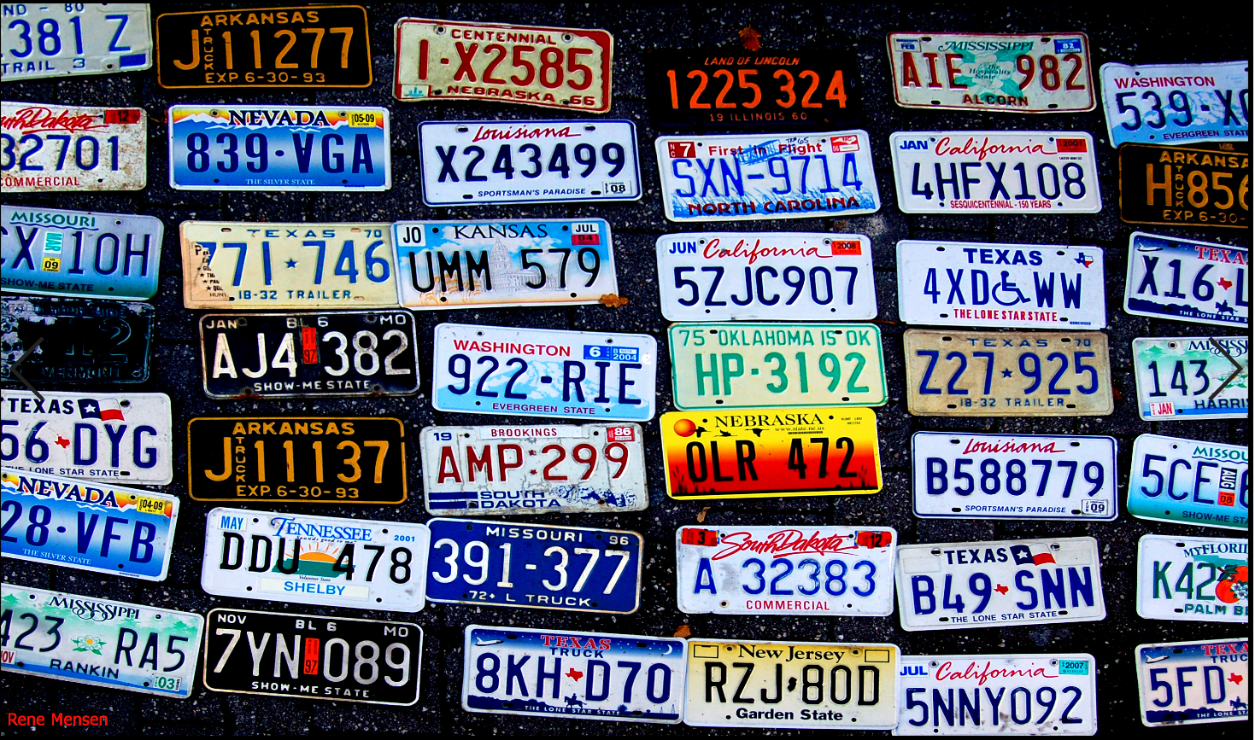
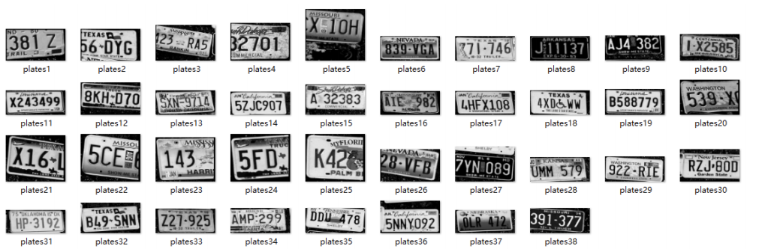
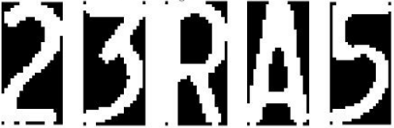
Project 4 License plate Reading
Wu Deming(吴德明） Niu Tianxing(牛天星）
2019232111 2019231051
{wudm, nittx}@shanghaitech.edu.cn

Slide 2
1.Objective
The license plate recognition technology requires that a license plate in motion can be extracted and recognized from a complex background. The license plate extraction, image pre-processing, feature extraction, license
plate character recognition and other technologies can be used to identify
the vehicle license plate and color information.
In order to perform license plate recognition, the following basic steps are required:1.License Plate Detection:Extract the license plate.Locate and segment license plate positions in pictures;2.Character Segmentation and Recognition: Extract characters from license plates and recognize the characters by using given templates;3.License plate character recognition:recognize the divided characters and finally form the license
plate number.
In this project.We want to use traditional image processing method to
finish the license plate reading.

Slide 3

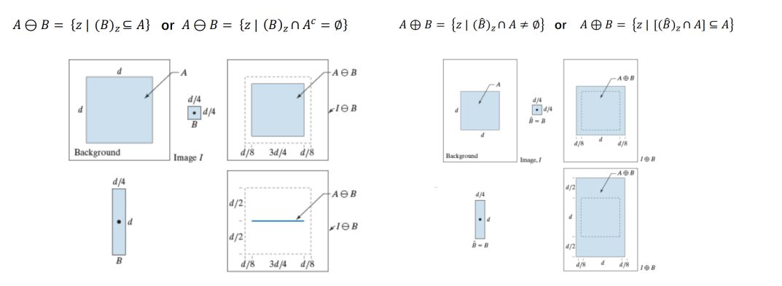
2.Prepare:
A.Morphological Image Processing
The basic morphological operations (erosion and dilation) are used to find the region of interest. The image is dilated and eroded with some structuring element and morphological gradient is used in order to detect the edges in the image.
Morphological image processing is a collection of non linear operations related to shape or morphology of features in an image. The operation is based on the relative ordering of the pixels not on their values. The morphology is performed using the structuring element which is also a binary image. Basic operations for the image morphology are erosion and dilation.

Slide 4
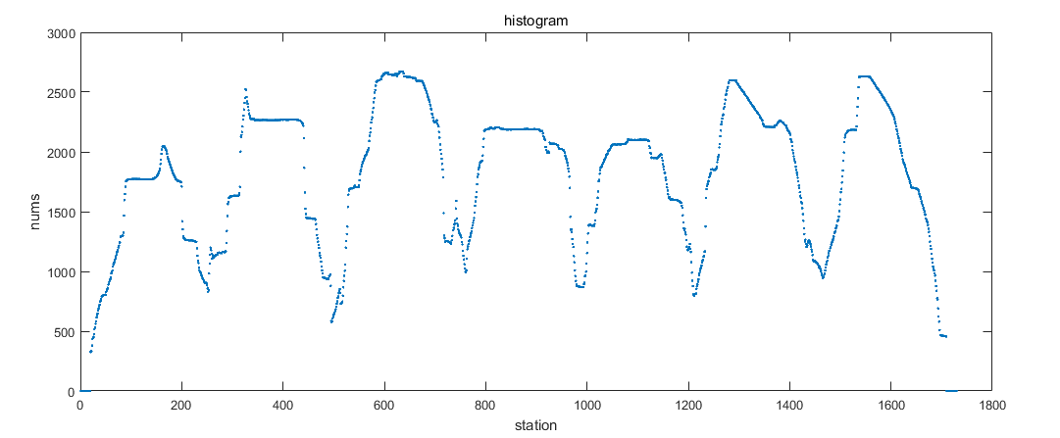
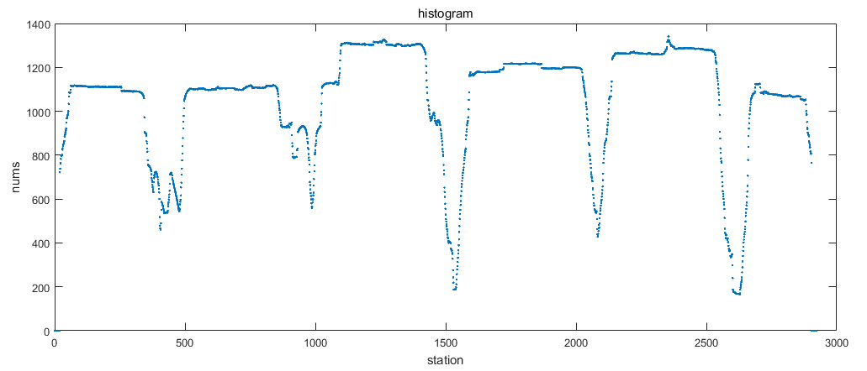
2.Prepare:
B.Vertical projection
The projection of the corresponding direction of the image is to take a straight line in that direction, count the number of black points of the pixels on the image perpendicular to the straight line (axis), and accumulate the sum as the value of that position on the axis; the cutting based on the image projection is to divide After the image is mapped to this feature, the cutting position (coordinates) of the image is determined based on this feature, and the original image is cut using this coordinate to obtain the target image.
In character segmentation,the main task of the horizontal projection analysis of the binary license plate image is to calculate the starting (rising point), ending (falling point) position, character height (peak width), and character center of the characters on each license plate from the obtained projection histogram. Distance (peak center position), character spacing (bottom width), and the position of the top and bottom borders of the character. Finally, we find the maximum height of license plate characters and remove the upper and lower border of license plate.

Slide 5
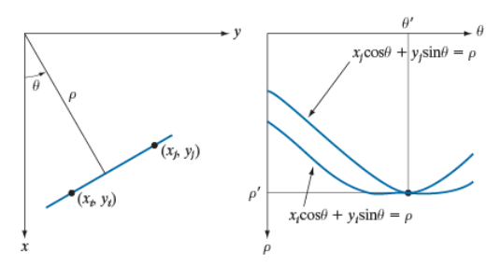
2.Prepare:
C.Hough and Radon transform
Algorithm of vehicle license plate tilt correction based on Hough transform: In this project, We hope to perform skew correction on the segmented picture to improve the accuracy of character recognition. Steps are as follows:
1. Image preprocessing, remove discrete noise points;
2. Use edge detection to enhance horizontal lines in the image;
3. Use Hough transform to detect the border of the license plate;
4. Determine the tilt angle of the border line;
5. Rotate according to the tilt angle;
6.Obtain a corrected image.

Slide 6
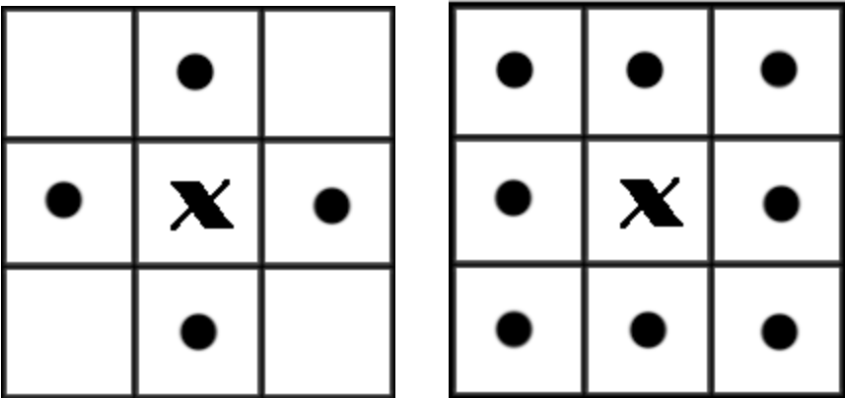

2.Prepare:
D.Connected Region
Connected region generally refers to the image region composed of foreground pixels with the same pixel value and adjacent position. Connected region analysis is to find and mark each connected region in an image. Generally, the object of connected region analysis is a binary image. In the image, the smallest unit is a pixel, and there are 8 adjacent pixels around each pixel. There are two common adjacencies: 4 adjacencies and 8 adjacencies

Slide 7
3.Project Flow
A)Preprocessing
Convert the image to gray scale image, and then set appropriate threshold to change the image to binary image;Denoising with Gaussian function;Use erosion operation and opening operation for images to make edges clear.
B) License Plate Detection&Segmentation
1) Using vertical projection to find License plate edge information
2) Find each license plate area by region connection method
Then,we can get many Independent license plate from image.
C) Skew correction
Using Hough and Radon transform to correct the skew of independent license plate, which is convenient for character cutting
D) Character Segmentation
1) Using region connectivity to recognize the character part and cut it
2)Using the projection operation to determine the char position information
E) Character Recognition
compare the cut independent letters with the characters in the template library to match the most similar letters.One important point:Letters and backgrounds may be black or white in a binary diagram.

Slide 8
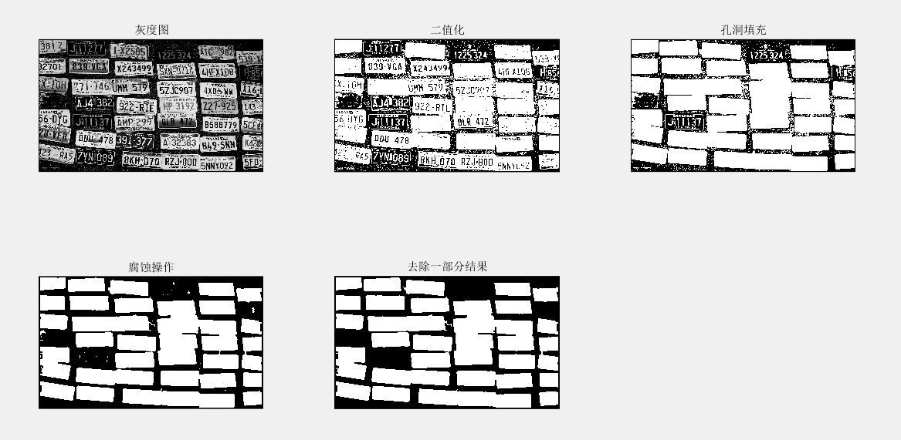
4.Result&Compare

Slide 9
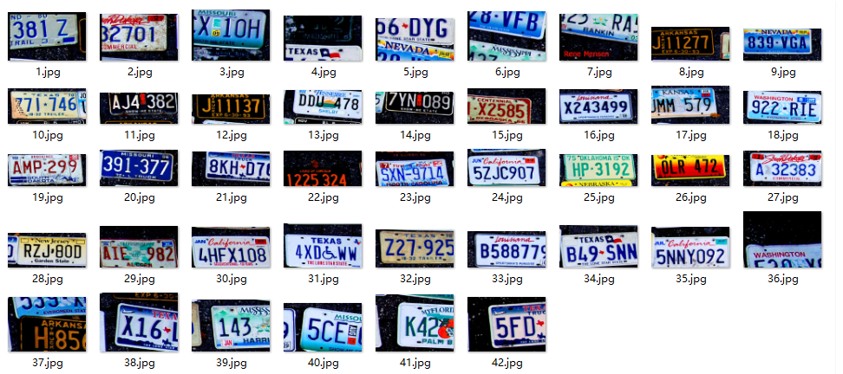
4.Result&Compare

Slide 10
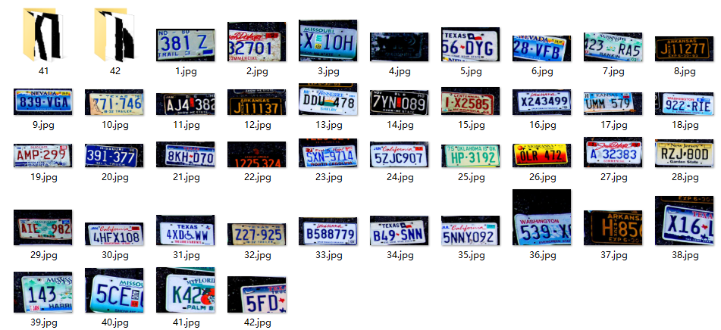
4.Result&Compare

Slide 11
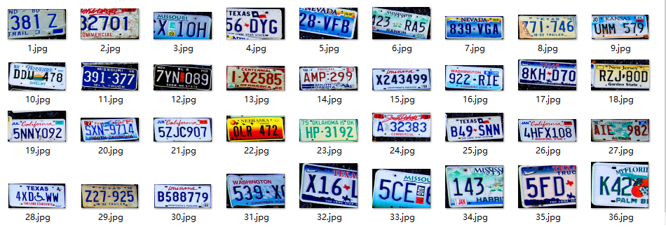
4.Result&Compare

Slide 12
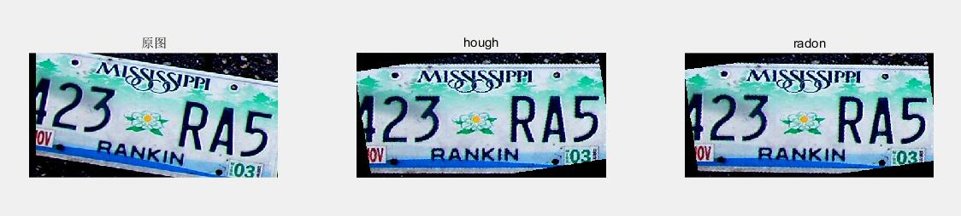
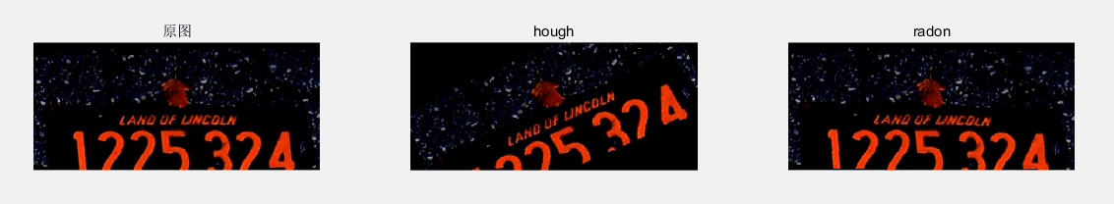
4.Result&Compare

Slide 13
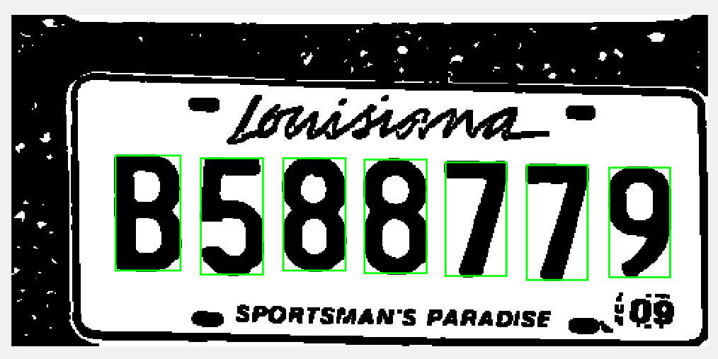
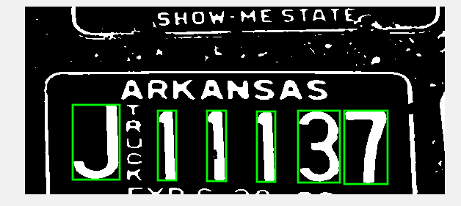
4.Result&Compare

Slide 14
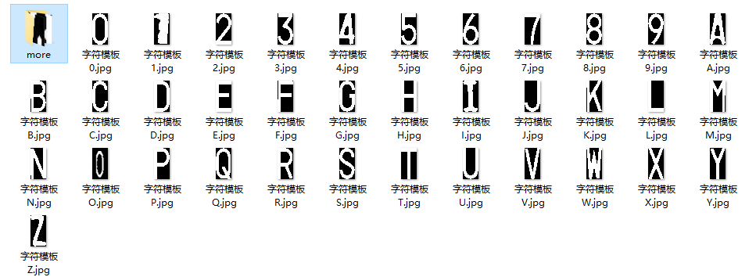
4.Result&Compare

Slide 15

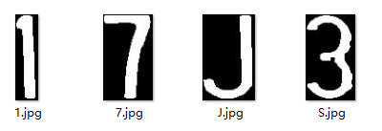
4.Result&Compare

Slide 16
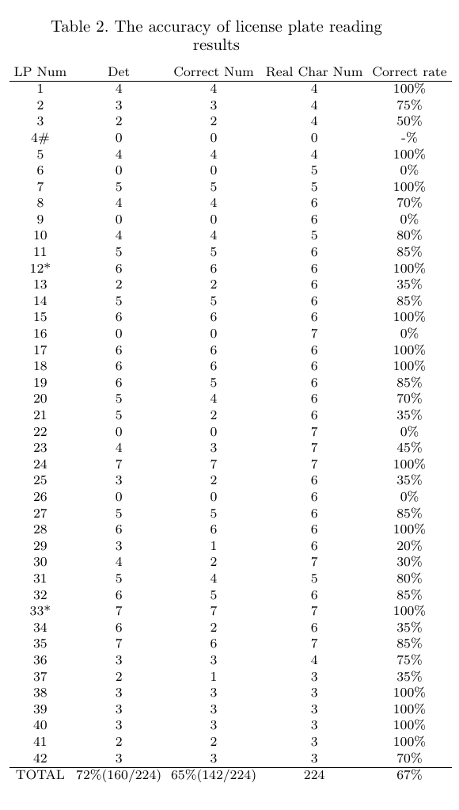
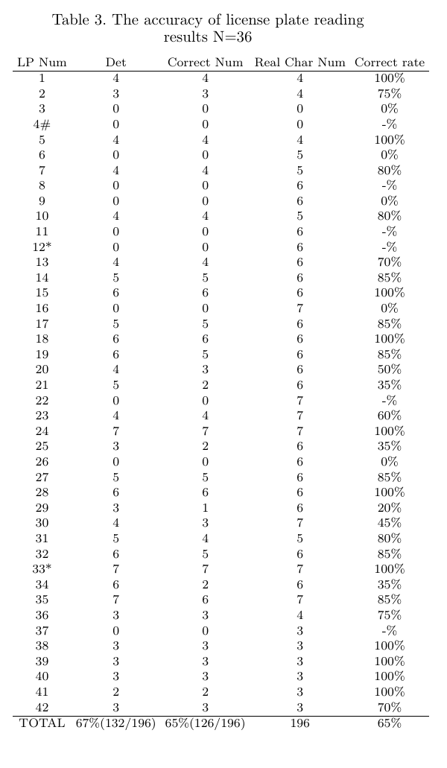
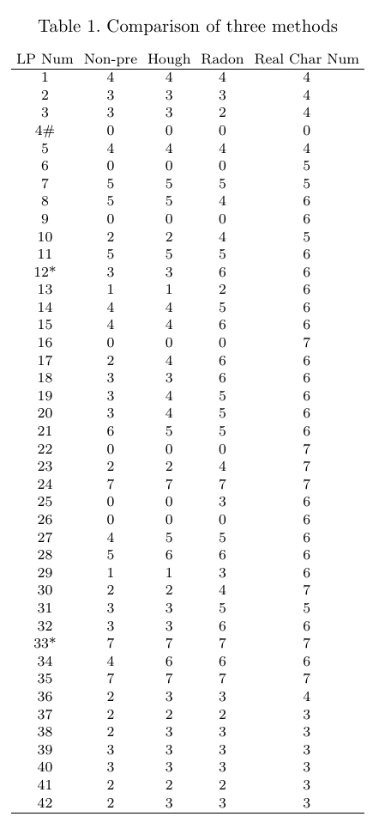
4.Result&Compare

